Slide 1
Real-Time Multimedia Content Management Engine
Power Dominion Enterprise.
Vance King Saxbe. A.

Slide 2
PROPOSED SOLUTION & FEATURES
The proposed solution is capable of replacing an existing analog recorder with a digital recording solution that captures, archives and retrieves high quality multimedia information whenever required.
Forensic Evidence Compliances
Security
Easy Access of Records
Disaster Recovery
Recorder
Easy Reports
Digital Note -taking
Features
Language Compatibility
Digital Recording

Slide 3
SYSTEM PROPOSED FOR RTMCM WORKS WITH 2 OPTIONS :
INITIATOR
AUTO TASKSCHEDULER

Slide 4
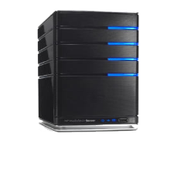















RTMCM SYSTEM WITH INITIATOR
Primary Server
DB2/Oracle
(EviCrypto, EviDigital)
UDB
Hadoop Cluster
Secondary Server
(EviCrypto, EviDigital)
Video conferencing Unit
Scheduler
Local Server
Portal
Compliance
Manager
Recorder
Authorized Users
Storing
Editing
Initiator
EVIDENLIGHT
EVIMEDIA
EVIEDIT
EVIPLAYER

Slide 5

RTMCM With Auto Task Scheduler
Primary Server
DB2/Oracle
(EviCrypto, EviDigital)
UDB
Hadoop Cluster
Secondary Server
(EviCrypto, EviDigital)
Video Conferencing Unit
Auto Task Scheduler
Local Server
Portal
Compliance
Manager
Authorized Users
Authorized Users
Storing
Editing
EVIDENLIGHT
EVIMEDIA
EVIEDIT
EVIEDIT
EVIDENLIGHT
EVIMEDIA

Slide 6
COMPONENTS
EVI
MEDIA
EVI
PLAYER
EVI EDITOR
EVI RECORDER
EVIDIGITAL
EVICRYPTO

Slide 7
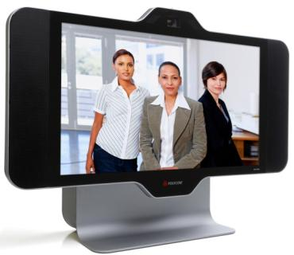
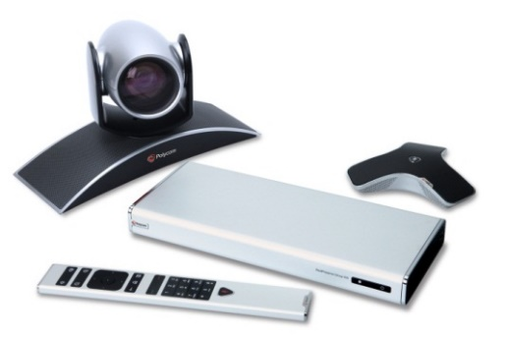
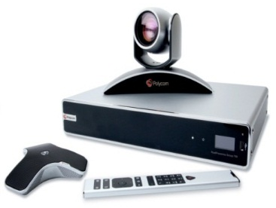
Polycom HDX 4500
Proposed Polycom endpoints
Polycom GS 500
Polycom GS 700
Natural High Definition Video
1080p30 | 720p60 Video Standard
Dual monitor capable
Incredible Audio Quality
Stereo Surround Siren 22kHz wide-band audio
Powerful speaker system
Sharp Graphics and Content Sharing
Up to 1080p content resolution for H.239 content sharing
Bright screen for true color representation
Notes:
In summary, let me close with some of the key reasons that customers choose Polycom. This is what they tell us.
Easy to use: to drive adoption and ROI.
2) Open standards-based interoperability: to eliminate collaboration silos caused by systems that don’t talk to each other. This is the foundation of our unique approach, our vision, our industry leadership, our ecosystem orchestration, and our customer value.
3) Best TCO: Polycom solutions consume as much as 50% less bandwidth resources than alternative solutions, and much of the cost of UC is in the network.
4) Investment Protection: Through open standards, Polycom solutions are backward-compatible with your legacy investments and forward-compatible with new and emerging systems.
5) Broad range of solutions and delivery options: With our ecosystem bringing secure HD video collaboration to the broadest range of business, video, mobile, and social networking applications delivered on-premises, hosted, or with service providers from the “video cloud.”
6) Enterprise-level security and carrier-grade scalability: to ensure the scale, reliability, flexibility and consistency required of a well-managed enterprise solution, the Polycom RealPresence Platform can support up to 25,000 sessions and 75,000 devices in a single video event—five times more than our closest competitor.
And 7) Polycom + ecosystem = most complete, interoperable, seamless, enterprise UC solution that drives user adoption through ease of use and value and thus delivers the industry’s best ROI.

Slide 8



Abu Dhabi Data Centre
Al Ain Data Centre
RMX 4000
RMX4000
Interview Rooms
3rd party local recording solution (not Polycom)
Connected over high-speed connection between data centers
Investigator
Local Content Storage
Recorder
External Content Storage
External Content Storage
DMA & RPRM
DMA & RPRM
VCM 6.5 Appliance
VCM 6.5 Appliance
MS Sharpoint
Internal
SQL
MS Sharpoint
Internal
SQL
HTTP Portal Access to manually upload recorded interviews over LAN/WAN to EACH Content Manager SEPARATELY (2 uploads).
RPAD
Firewall
Firewall
RPAD
DMZ
WAN
DMZ

Slide 9
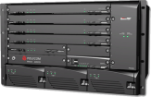
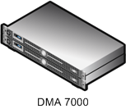

Scalability
DMA Virtualize Resources
Geographically Dispersed
Supercluster for additional
call capability
RMX 4000™
DMA™ 7000
DMA™ 7000 Super-Cluster
Resolution | Resources
Voice PSTN | 1440 400
CIF/HD VSW | 360
SD/4CIF | 240
HD 720p30 | 120
HD 720p60 | 60
HD 1080p30 | 60
RMX
MCU’s | Active Participants
64 | 5,000
MCU’s | Active Participants
64 | 25,000
MCU | Active Participants
1 | Flexible
Notes:
Building on the RMX4000, is the ability to virtualize a pool of not just RMX’s, but also the “formerly codian, now Cisco” elements. And then to group those pools into a super cluster.
This is just the beginning, as Polycom will continue to provide solutions to further scale, including desktop scale modes and SVC that will enable the SP to keep up with the growing demand, and allow the SP to address the growing desktop and UC video demands, and the merging of the enterprise with the consumer and mobile markets.

Slide 10
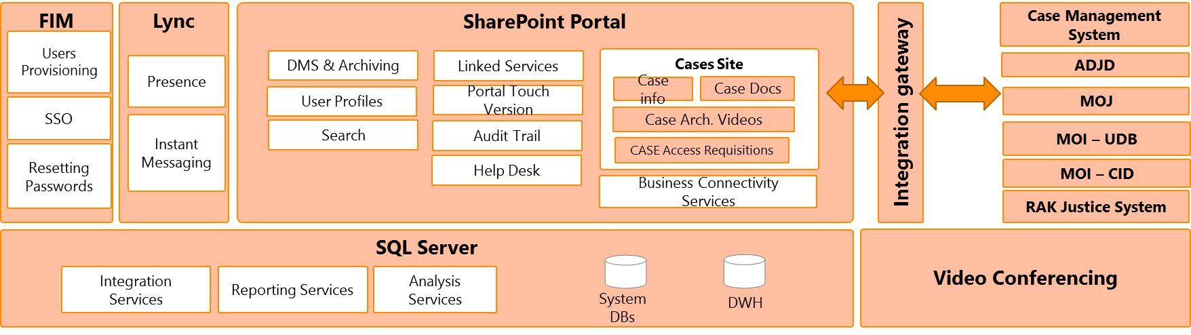
RTMCM Portal – Conceptual Architecture
build the Portal on top of Microsoft SharePoint
Portal will be bilingual (Arabic and English)
Other technologies included are
Microsoft Lync (for the support site)
Microsoft Forefront Identity Manager

Slide 11
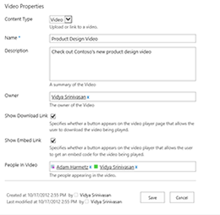
RTMCM Portal – Video Retrieval
Portal includes playback for the videos with features as
Browsing through recordings
Filter by metadata
Enterprise Search
And other content management features
Play, stop, rewind
Note: Video editing available through recording software only

Slide 12
COMPONENTS OF EJIS
EVI MEDIA
Works with Macintosh or Windows Pc’s with PCI Express Slots.
EVIPLAYER
Special player to be used by privileged users to view the court proceedings.
Eight stereo input and output with extensive on-board digital mixer.
Wide variety of sample rate sync options.
Compatible with Alesis ADAT Type 1 and Type 2 optical digital interface protocol.
Compatible with all kinds of television formats.
User friendly configurations for audio selection.
Ability to select no. of channels for recording and record single channel for each person involved.
No additional PCI slot is required
Has multiframes for HD 264 multimedia with detailed search with reference to case number, date, time, etc.
best-in-class performance, compression, and features.
Encoding video streams into the H.264/MPEG-4 AVC compression format
Achieves dramatic performance, encoding 4 or more 1080p streams in realtime on a single consumer-level computer with the best quality, having the most advanced psychovisual optimizations.
Support features necessary for many different applications, such as television broadcast, Blu-ray low-latency video applications, and web video.
Eviplayer uses x264 which forms the core of many web video services which can be widely used by television broadcasters and ISPs.

Slide 13
COMPONENTS OF RTMCM Cont.
EVI RECORDER
Evi Recorder is the user interface where the preview of the recording will be provided for the privileged user.
EVIEDITOR
Allows users to blur the faces of selected people within the video to enhance the level of protection.
Has multichannel input from various video conferencing units.
Provides detailed mentioning of log notes and annotations which are associated with the recorded files.
Allows to preview the blurred faces within the video with a few clicks before it is published to make sure everything is correct.
Provides higher degree of control over video signals by providing features like i. De-interlacing ii. Aspect Ratio Control iii. Digital Zoom and Pan iv. Brightness/ Sharpness adjustments v. Color Calibration and many such varied controls.
Can record and stream live HD264 Multimedia stream to a remote server for broadcasting and storage.
Built in Muxers and Demuxers.

Slide 14
COMPONENTS OF RTMCM Cont.
EVI DIGITAL
A digital signature algorithm includes a signature generation process and a signature verification process.
EVICRYPTO
The most crucial part of the Judiciary system is protection of its evidences. This, in case of RTMCM is ensured by Evi Crypto.
A signatory uses the generation process to generate a digital signature on data. A verifier uses the verification process to verify the authenticity of the signature.
Each signatory has a public and private key and is the owner of that key pair.
Pair owner is the only entity that is authorized to use the private key to generate digital signatures
Integrated cryptographic functions provide leading cryptographic performance and functionality (AES 256)..
not crack able since the combinations of keys are massive.
NSA has categorized this in Suite B, they have also recommended using higher then 128-bit keys for encryption.

Slide 15
WORKING OF DSA ALGORITHM
MESSAGE DIGEST
MESSAGE DIGEST
SIGNATURE DIGESTION
SIGNATURE VERIFICATION
Private Key
Public Key
Valid
Invalid
Signature

Slide 16
WORKING OF DSA ALGORITHM Cont.
Using Digital Signature Algorithm (DSA)
Actions
Assurance
Get the claimed Signatory,s identifier
Obtain Assurance of the claimed signatory’s identity
Obtain the domain parameters and public key
Obtain Assurance of domain parameter validity
Generate a message digest
Obtain Assurance of the validity of the owner’s public key
Obtain Assurance that the owner possess the private key
verify the digital signature
Digital Signature Validation Complete

Slide 17
SECURED DATA TRANSFER USING ENCRYPTION
ENCRYPTION IN EVICRYPTO
Protection through strong encryption (AES 256 bit standard EVI CRYPTO) to provide confidentiality and integrity of the stored Video Conference and at the central storage sites in a fully secured manner through the use of digital signatures (EVI DIGITAL), to ensure that the interviews are stored securely and if any alterations found, it can be proved.
AES is based on a design principle known as a substitution-permutation network, and is fast in both software and hardware.
AES operates on a 4×4 column-major order matrix of bytes, termed the state, although some versions of Rijndael have a larger block size and have additional columns in the state. Most AES calculations are done in a special finite field.
The key size used for an AES cipher specifies the number of repetitions of transformation rounds that convert the input, called the plaintext, into the final output, called the ciphertext. The number of cycles of repetition are as follows:
10 cycles of repetition for 128-bit keys.
12 cycles of repetition for 192-bit keys.
14 cycles of repetition for 256-bit keys.
Each round consists of several processing steps, each containing five similar but different stages, including one that depends on the encryption key itself. A set of reverse rounds are applied to transform ciphertext back into the original plaintext using the same encryption key.

Slide 18


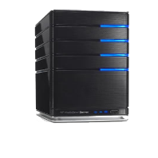



DATABASE AND INTELLIGENCE
IBM DB2 Database Server/ Client (Relational Database Management System)
IBM Big Insights (Hadoop/ Hadoop Distributed File System)
Backup 2
UDB
Hadoop Cluster
Secondary Server
(EviCryptor, EviSecure)

Slide 19


PROPOSED SOLUTION
Initiator
Auto Task
Scheduler

Slide 20
WORKFLOW WITH INITIATOR
Recorder
Video conferencing
Initiator
Stop
Recording
Compliance Manager
Primary server(EviDigital, EviCrypto)
Local Server
Authorized Users(Eviden Light ,Evi Media, Evi Edit)
Portal
Secondary Server
Hadoop Cluster
Storing
Editing

Slide 21
WORKFLOW WITH AUTOTASK SCHEDULER
UDB
Auto Task Scheduler
Video Conferencing Unit
Primary server(EviDigital, EviCrypto)
Local Server
Stops Recording
Compliance Manager
Portal
Secondary Server
Hadoop Cluster
Authorised Users(Eviden Light ,Evi Media, Evi Edit)
Storing
Editing

Slide 22
RTMCM COMPLIANCE
General/ Police Interview Room Compliance
The Child Interview Room Compliance
Portal
Compliance

Slide 23
THE ORIGINAL COMPLIANCE
EJIS
ADJD, MOJ, Dubai Justice System RAK, MOI, UDB, CID
Video Conf Unit
Telephone System Used in Judicial Organisation
Central Server
Local Sever
Compliance Manager
PORTAL
Authorised Users

Slide 24





ADDITIONAL COMPLIANCE
EJIS
Court(Large, Medium, Small)
UDB
Video Conferencing Unit
Case Management System
Auto Task Scheduler
Telephony System Used in Judicial Organizations
Compliance Manager
Portal
24

Slide 25
POLICE INTERVIEW ROOM COMPLIANCE
EJIS
POLICE INTERVIEW MONITORING ROOM
Video Conferencing unit
Telephone System Used in
Judicial Organisations
Local Server
RTMCM PORTAL
Compliance Manager
Central Server
AUTHORISED USERS

Slide 26
CHILD INTERVIEW ROOM COMPLIANCE
CHILD INTERVIEW MONITORING ROOM
Audio & Video Conf Unit
Telephone System Used Judicial Organisation
Compliance Manager
Local Server
SERVER
RTMCM PORTAL
AUTHORISED USERS

Slide 27
PORTAL COMPLIANCE
SERVER
RTMCM Portal
Compliance Manager
ACCESS TO VARIOUS CMS
RTMCM USER ADMINISTRATION ON SERVICE
RTMCM SCHEDULE MANAGEMENT SERVICES

Slide 28
DATABASE INTEGRATION
DB2
PORTAL

Slide 29
DATABASE INTEGRATION
WITH Case Management System
Unified Database Model (UDB)
SetUp/
Auth Data
Storage/Retrieval
App Data
Storage/Retrieval
DB
DB2 SERVER
Data Security/
Encryption
IBM BIG INSIGHTS
Case History/
Tracking
Video Analytics
Log Analytics
Forensics
Audio/Video/
Image Data
Storage/Retrieval
Adhoc Query & Analysis

Slide 30
DATABASE INTEGRATION
With Portal
User of EviPlayer
Portal
EviPlayer
Search For files with Keyword
Stream file
Database

Slide 31
RTMCM SOLUTION PHASE
Phase - I
RTMCM Components
IBM InfoSphere BigInsights
RTMCM Components
Enterprise Components for Advanced Video Recording Solution.
IBM Infosphere BigInsights
RTMCM Analysis features would be build on the Hadoop distributed computing platform.
For RTMCM Analysis will have IBM Infosphere BigInsights

Slide 32

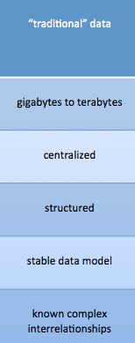
BIG DATA INSIGHTS
Big Data Insights
Ensures speed and scalability, mobility and security, flexibility and stability
Integration of both structured and unstructured data
The realization time to information is critical to extract value from various data sources including mobile devices, radio-frequency identification (RFID), the Web and a growing list of automated sensory technologies

Slide 33














BIG DATA INSIGHTS Cont.
Analytic Applications
BI / Reporting
Exploration / Visualization
Functional App
Industry App
Predictive Analytics
Content Analytics
IBM Big Data Platform
Visualization & Discovery
Application Development
Systems Management
Accelerators
Hadoop System
Stream Computing
Data Warehouse
Information Integration & Governance

Slide 34
ADAPTIBILITY AND EXTENDIBILITY
EXTENDIBILITY
ADAPTIBILITY

Slide 35
ADAPTIBILITY & EXTENDIBILITY
Phase 1
Phase 2
Phase 3
Future Enhancement of RTMCM can be made in :
Phase 2
Video Analytics and Facial Recognition
Phase 3
Smarter Decision Making

Slide 36
ADAPTIBILITY & EXTENDIBILITY RTMCM PHASE 2 Cont.
Enhancement for RTMCM in Phase II & III will have Video Analytics, Facial Recognition
In house Development
With IBM
EVI VISION
Face Recognition
Motion Analysis
Scene reconstruction
EVIINTELLIGENCE
Intelligent inference
IBM Intelligent Video Analytics.
IBM WATSON
Artificial Intelligence domain

Slide 37
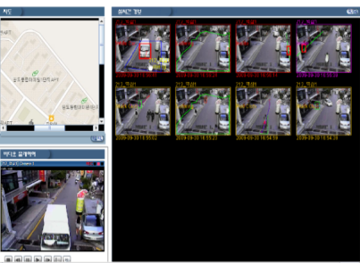
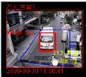
ADAPTIBILITY & EXTENDIBILITY RTMCM PHASE 2 Cont.
IBM Intelligent Video Analytics
Analytics indexing
events
Real-time
Alerting

Slide 38
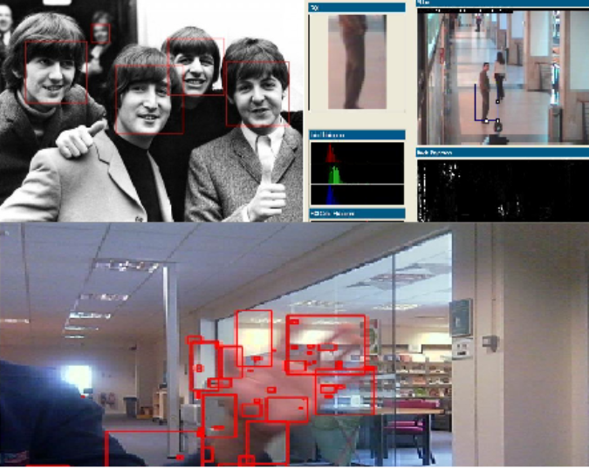
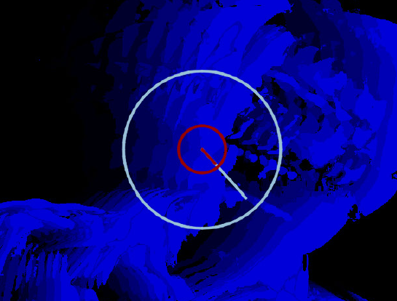
ADAPTIBILITY & EXTENDIBILITY - RTMCM PHASE 2 RECOGNITION & SCENE RECONSTRUCTION

Slide 39




ADAPTIBILITY & EXTENDIBILITY - RTMCM PHASE 3
Watson
IBM Watson, IBM IOC & Smarter Government
Generates and evaluates evidence-based hypothesis
Understands natural language and human communication
I.O.C Integrates all components of government bodies.
Adapts and learns from user selections and responses

Slide 40
RTMCM Architectural Framework

Slide 41
TOGAF Framework
The development RTMCM solution is based on an iterative process model, which helps in revolutionizing a re-usable set of architectural asset.
The best practice for such a development strategy is by the use of an Enterprise Architectural Framework , TOGAF.

Slide 42
Architecture Content Framework Overview
During the execution of the ADM a number of outputs will be produced as a result, such as process flows, architectural requirements, project plans, project compliance assessments, etc. In order to be able to collate and present these major work products in a consistent and structured manner, it is necessary to have an Architecture Content Framework within which to place them. This allows for easier reference and standard classification, and also to help facilitate the structuring of relationships between the various constituent work products that make up what is often referred to as the “Enterprise Architecture”.

Slide 43
PMBOK
We using The PMBOK organize the project management process into five groups.
The groups follow the project life cycle and consists of total process found in PMBOK
Initiate
Plan
Executing
Monitoring & Controlling
Closing

Slide 44
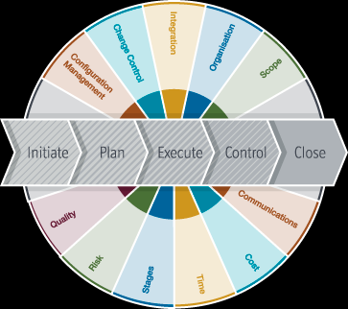
PMBOK Overview:

Slide 45
Project Management
Ensures :
Provide WorkBreakDown Structure(WBS) using Microsoft Soft project
Follow Project process standard
Provide qualified,certified and experienced project
management staff.
Provide Project progress report and proper maintenance of project time plan and charter.

Slide 46
THANK YOU.

